Slide 1
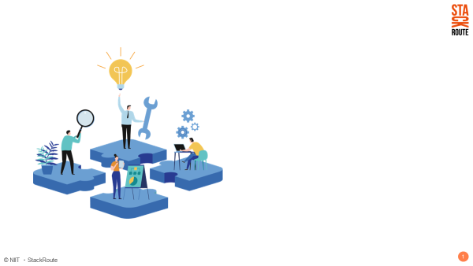
Amazon Product Review Analysis
Sukrit Singh Negi

Slide 2
CASE STUDY
Amazon Product Review Analysis:
Categories taken for analysis : Beauty and Clothing-Shoes-Jewelry
Data Source : http://jmcauley.ucsd.edu/data/amazon/
Each category contains two datasets: product ratings & product reviews
Data size : Rating = 7771990 observations, Review = 477179 observations

Slide 3
DATA DESCRIPTION
Rating Dataset
reviewerID : UserId of the reviewer
item : Id of the product
rating : rating of the product
timestamp : time of the review
Review Dataset
reviewerID : ID of the reviewer
asin : ID of the product
reviewerName : name of the reviewer
helpful : helpfulness rating of the review, e.g. 2/3
reviewText : text of the review
overall : rating of the product
summary : summary of the review
unixReviewTime : time of the review (unix time)
reviewTime : time of the review (raw)

Slide 4
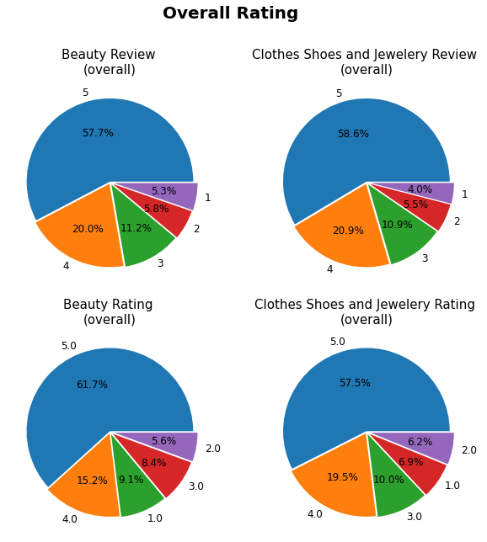
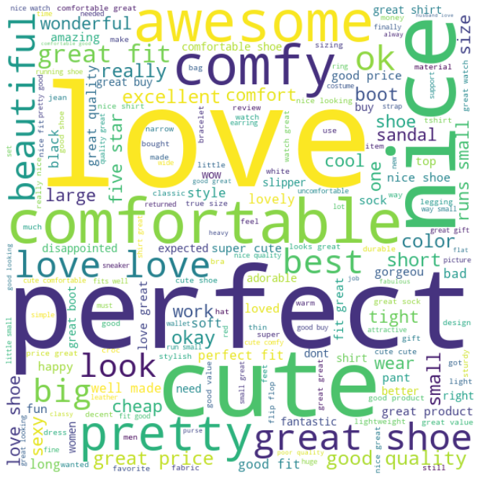
EXPLORATORY DATA ANALYSIS (EDA)

Slide 5
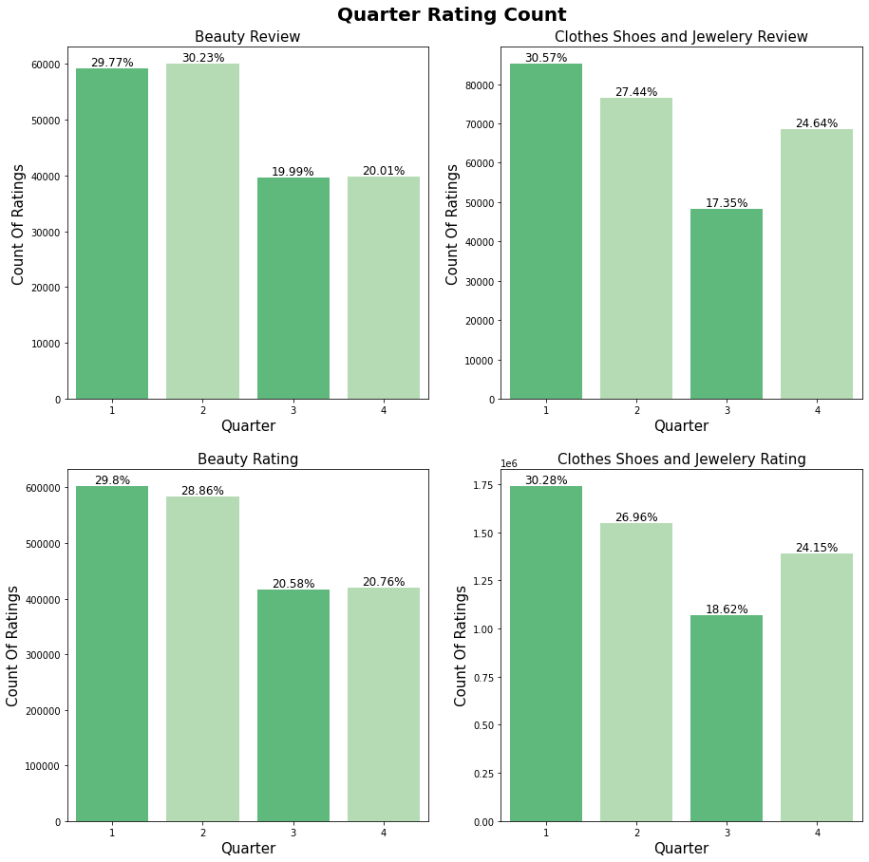
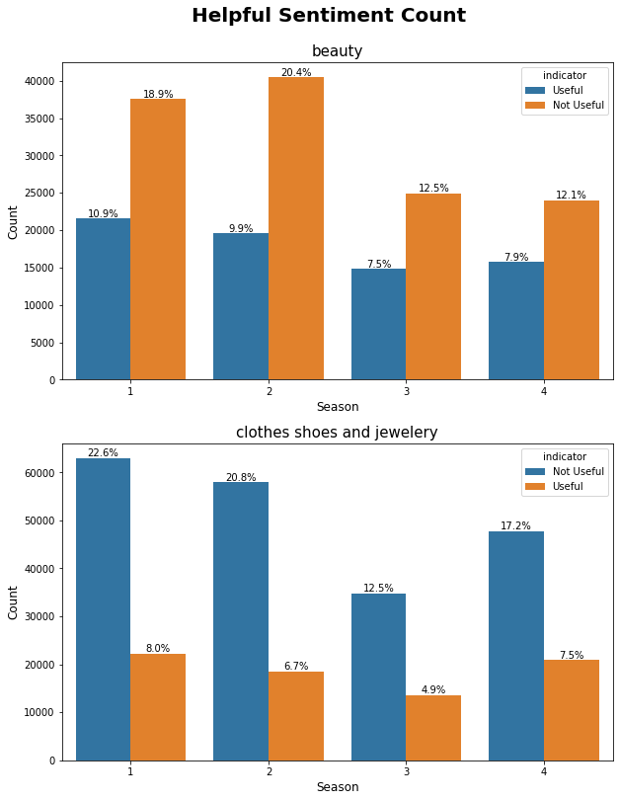

Slide 6
DATA PREPARATION
Rating and Review datasets for both the categories have been concatenated respectively.
Null Value Treatment
Type Casting
TEXT PREPROCESSING
Text have been expanded from contraction to full words.
Websites, Emails, Special Character, Numbers have been removed.
Text has been lemmatized.

Slide 7
SENTIMENT ANALYSIS
Model Building and Predictions
Processed text from the reviewText and summary column were the chosen features for model development.
Initially TextBlob was used but found to be less accurate than expected. (Accuracy : 80.1%)
RandomForestClassifier was chosen after transforming the data using TfidfVectorizer(). Model improved significantly and has been used for further analysis. (Accuracy : 91.4%)

Slide 8
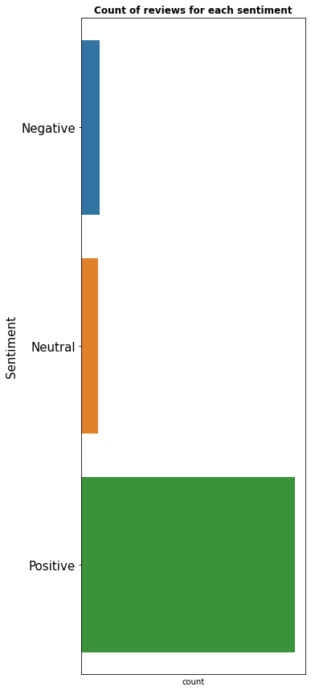
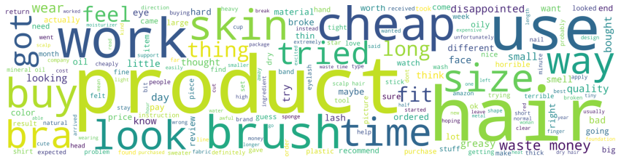
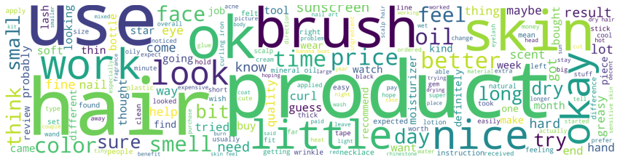
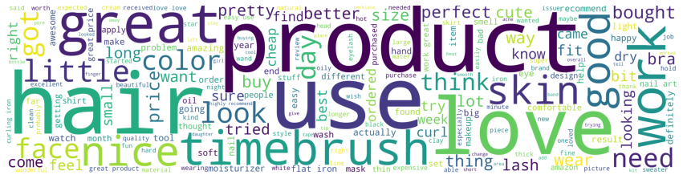

Slide 9
RESULTS
POSITIVE | NEGATIVE | NEUTRAL
I was very happy to get this palette, now I wish it was offered in subscription form like some of the makeup we use daily is. You get a good amount of product for your money here, so this is well worth the cost. Very nice palette! | Very oily and creamy. Not at all what I expected... ordered this to try to highlight and contour and it just looked awful!!! Plus, took FOREVER to arrive. Don't waste your money | This palette was a decent price and I was looking for a few different shades. This palette conceals decently, however, it does somewhat cake up and crease. OK Palette!
We gave these as gifts and everyone that received this screamed after they put it on. Talk about happy campers. This stuff is great!!! Happy | This gel did nothing at all. I religiously put it on specific areas for weeks and nothing changed. DON'T WASTE YOUR TIME Does nothing | It was a little smaller than I expected, but that was okay because it lasted me for a long time

Slide 10
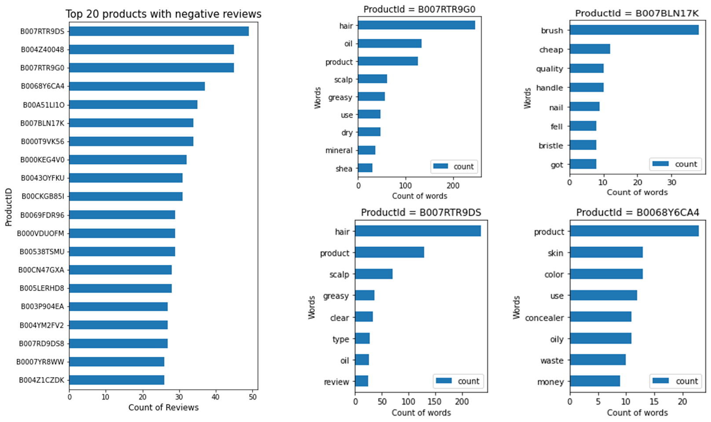
NEGATIVE REVIEW ANALYSIS
From the results of Sentiment Analysis, Negative Reviews have been filtered from the dataframe and graphically analyzed for plausible reason of negative reviews.

Slide 11
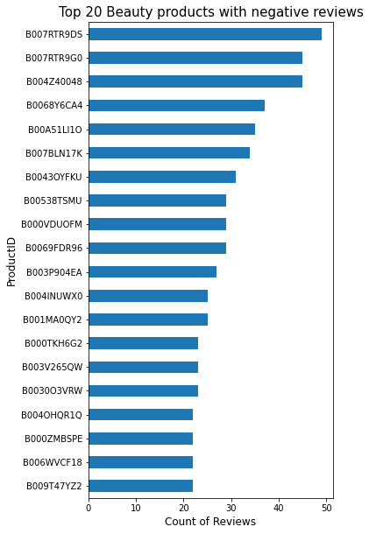
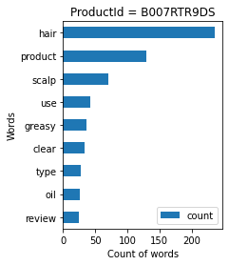
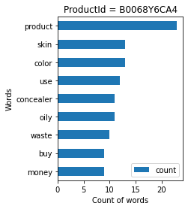
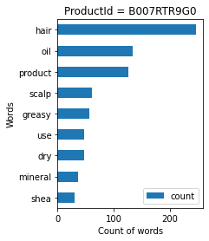
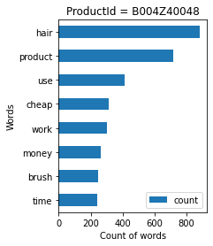
Beauty Products with Most Negative Reviews

Slide 12
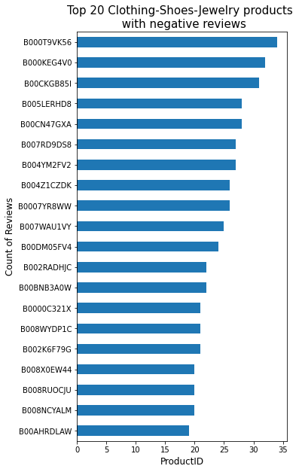
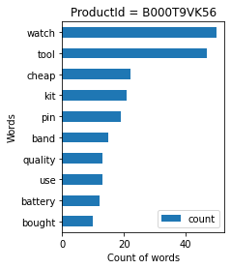
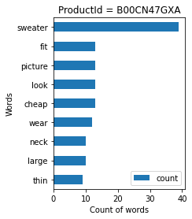
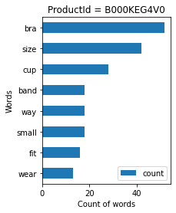
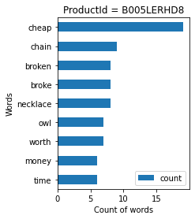
Clothing-Shoes-Jewelry Products with Most Negative Reviews

Slide 13
Analysing Reasons for Negative Reviews
Products
Product Id | Product Name | Reason
B007RTR9DS | Hair Product | The product is making the scalp and hair oily or greasy.
B007RTR9G0 | Hair Product | The product is making hair greasy
B007BLN17K | Hair Brush | The product is not of good quality. Handle is not up to the mark and bristles are falling off.
B0068Y6CA4 | Hair Product | Quality of the product is not good and seems cheap to the customers
Beauty Products
B007RTR9DS | Hair Product | The product is making the scalp and hair oily or greasy.
B0068Y6CA4 | Hair Product | Quality of the product is not good and seems cheap to the customers
B007RTR9G0 | Hair Product | The product is making hair greasy
B004Z40048 | Hair Brush | The product is not of good quality.
Clothing Shoes Jewelry Products
B000T9VK56 | Watch | The product is not of good quality and have battery issues.
B00CN47GXA | Sweater | The product is not of good quality and does not fit well.
B000KEG4V0 | Lingerie | The product size are not properly mentioned.
B005LERHD8 | Necklace | The product is not of good quality and chain breaks easily.

Slide 14
TIME SERIES ANALYSIS
DATA PREPARATION
Six different dataframes were created using the results of Sentiment Analysis, one for each sentiment : Positive, Negative and Neutral and for each category : Beauty and Clothes-Shoes-Jewelry.
Model Building and Predictions
For each dataset and sentiment, data has been resampled by month.
SARIMA Model has been used to forecast the trend for each sentiment in the respective categories.
RESULT: The trend has been analyzed graphically.

Slide 15
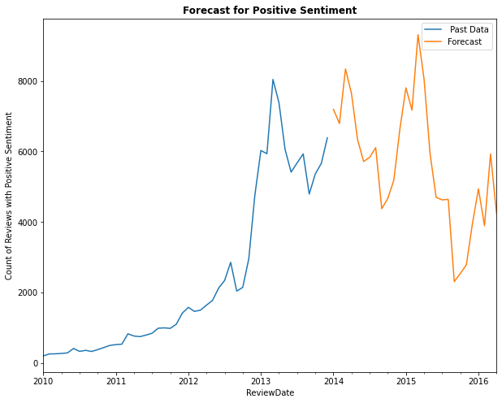
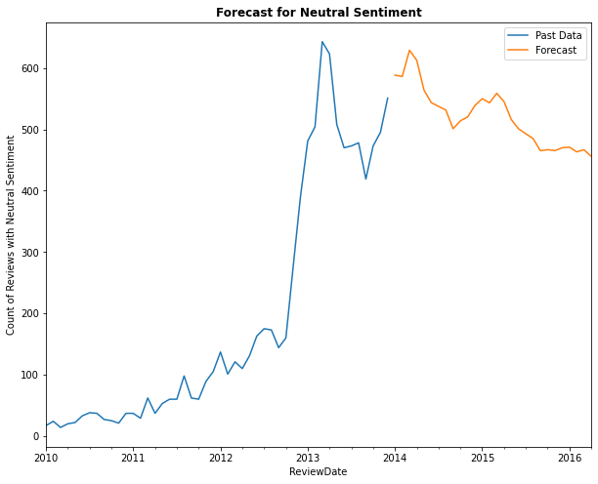
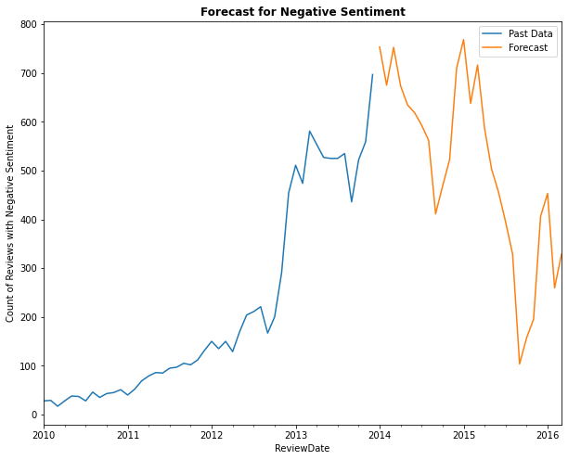
BEAUTY

Slide 16
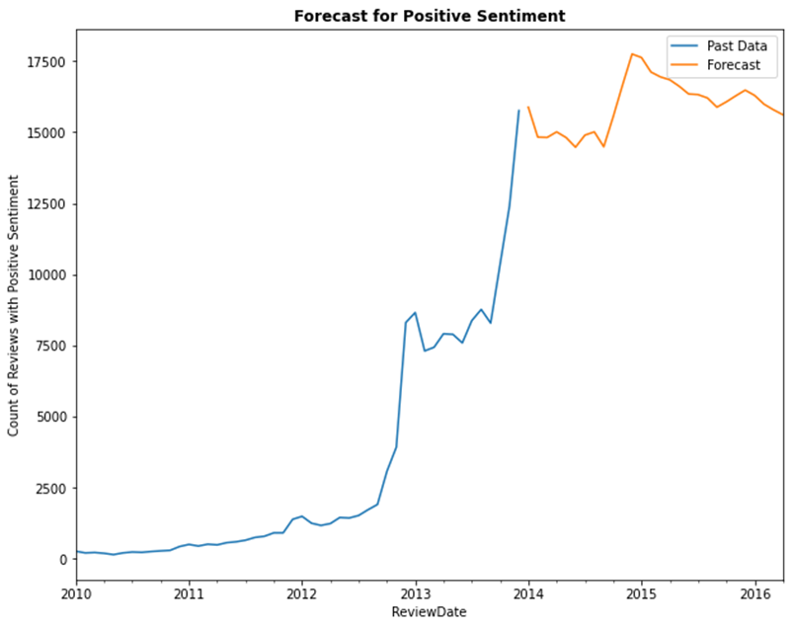
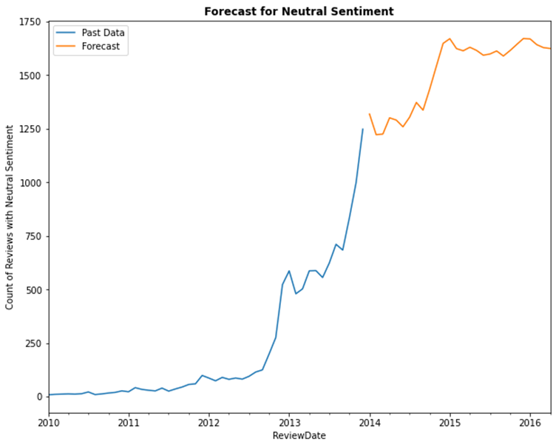
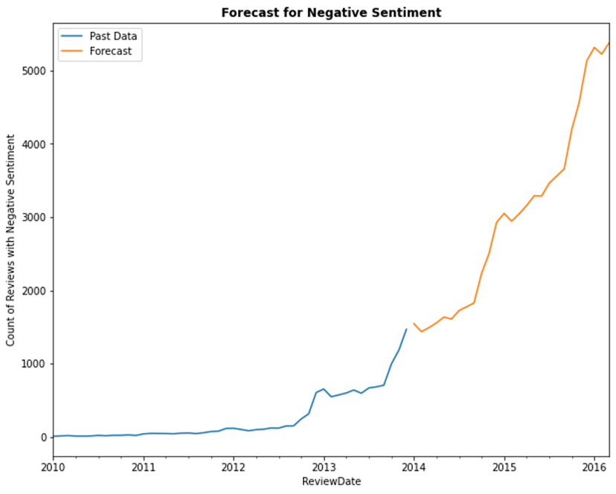
CLOTHES-SHOES-JEWELRY

Slide 17
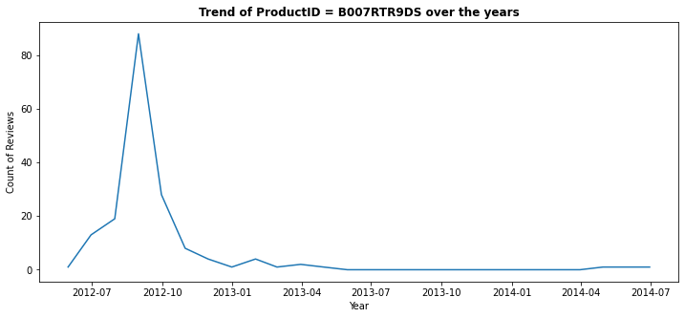
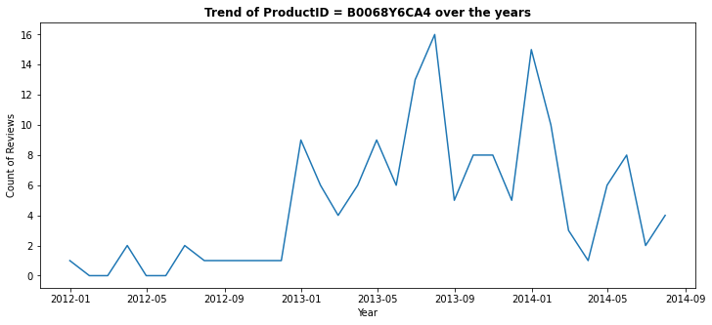
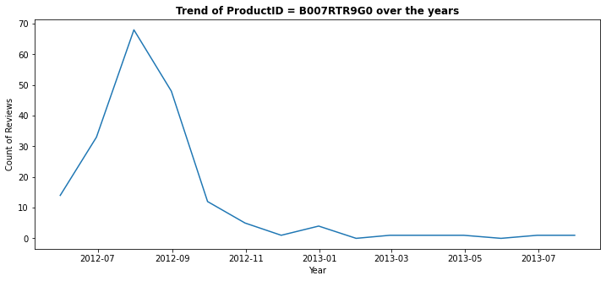
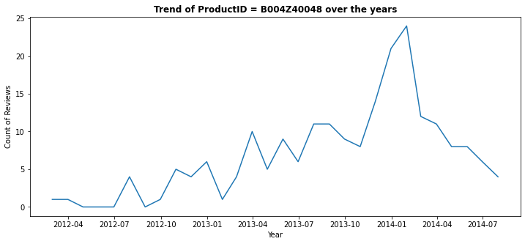
BEAUTY PRODUCT

Slide 18
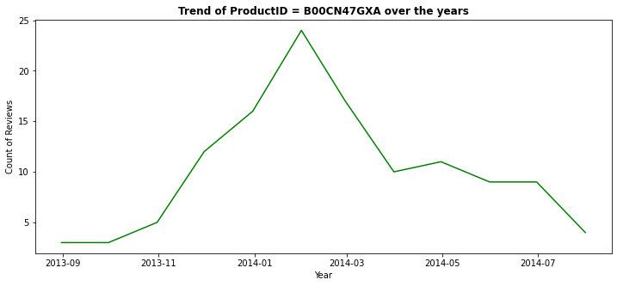
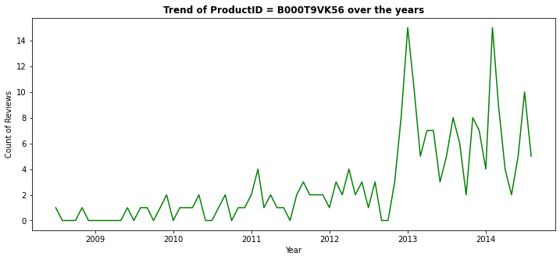
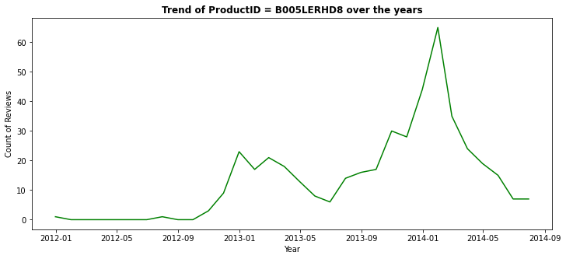
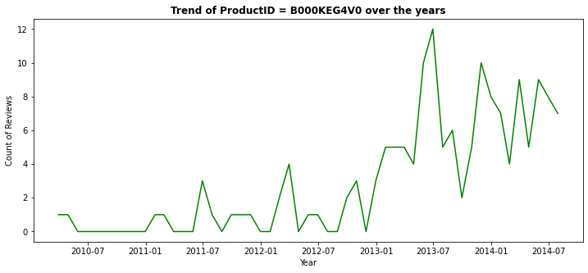
CLOTHES-SHOES-JEWELRY PRODUCT

Slide 19
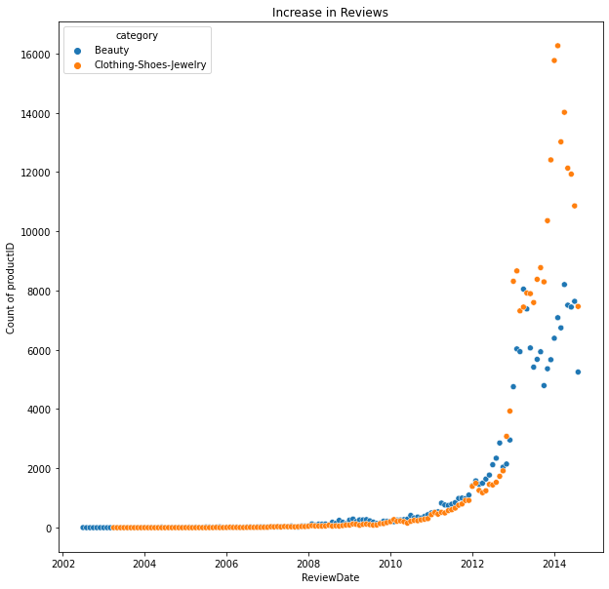

Slide 20
THANK YOU

